Slide 1
Eurographics 2014 – Strasbourg – France
Notes:
Instructions for technical presentation:
* The provided Windows-based PowerPoint 2010 presentation is to be used for the fast-forward session. You may use it as a template for the technical session. This not mandatory.
Instructions for fast-forward session:
* The use of the provided Windows-based PowerPoint 2010 presentation is mandatory for the fast-forward session.
* During this session, each of you will have 30 seconds to summarize your paper. Every paper must be represented by one or more of its authors.
* You may insert any number of slides, each of which must automatically advance to the slide beyond it (including the last one), adding up to a maximum of 30 seconds.
* Your slides may contain audio, and video.
* Try to keep the total size of your materials (PowerPoint, audio, and video) to 40 MB or less.
* We will concatenate all of the presentations into one large presentation, which will be played on a Windows-based computer.
* To avoid problems with the final presentation, no last minute changes can be accepted. Please test your slides on setup similar to the target environment (fonts, animations, and video may behave differently).
Details:
Assembling these presentations is a huge task, and we request that you help by adhering to the following guidelines:
* Each presentation begin with a 5 seconds slide (showing the EG2014 logo) : it provides time for next authors to get to the podium, while previous ones get off the stage.
* Then, a second 5 seconds slide will show your paper title with the names of authors and affiliations : you are responsible to complete this slide
* Then, your own slides will be display : you should use the provided template, but change will be accepted as long as the two first slides remain unchanged. The total time for your slide is limited to a total of 30 seconds.
* Your presentation will end with the next EG2014 logo slide lasting 5 seconds, during which you should leave the stage allowing the next presenter to hop on and reach the podium in time.
* The entire fast forward presentation will be pre-recorded, with all timings and slide changes built in. You will not have the ability to go back to a previous slide or to make a slide last longer. Be prepared to simply let the presentation run.
* There might be a keyboard and mouse on stage, but the whole show is automated. Presenters WILL NOT be able to manually control slide changes.
* Some slides corresponding to Session Title slides will be inserted. These slides will last 10 seconds on screen and are intended to let the audience catch their breath.
Technical Guidelines:
* As stated above, all slides in your presentation must automatically advance to the next with a fixed time, the last one included.
* Audio is welcome. If you use audio in your slides, please have it be in mp3 format.
* Video files are also welcome, these should be in WMV format exclusively; please do NOT use QuickTime (.mov) formats for your video, since unfortunately these will not play in PowerPoint running under Windows.
* When importing video, please make sure to select the option "Start Playing Automatically", when prompted.
* If you plan to include mathematical equations, we suggest that you embed them as images and not active objects, since font discrepancies may cause parts or all of your equations to be shifted or entirely changed in some cases.
* More generally, we suggest that when introducing regular text you use only the standard fonts that ship with Windows. If you wish to use any other fonts, you should convert the text to an image and then embed the image in place of the text.

Slide 2
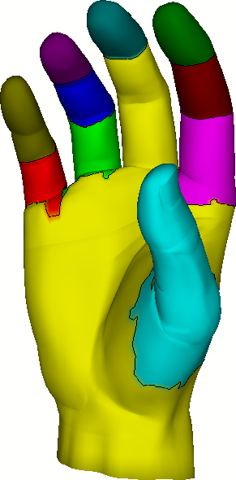
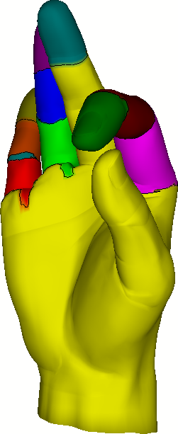
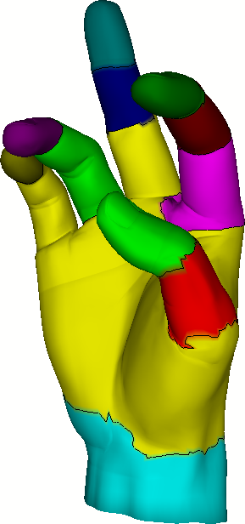
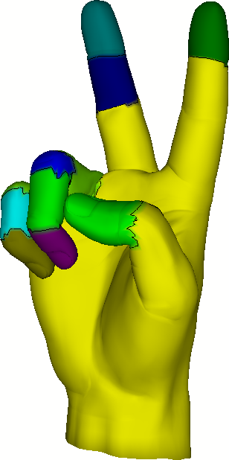
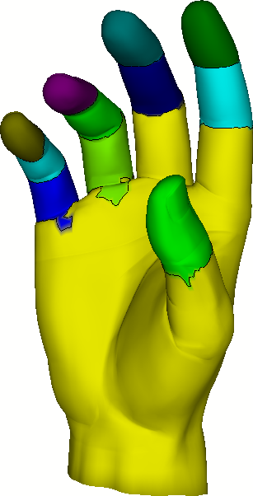
Pose Partitioning for Multi-resolution Segmentation of Arbitrary Mesh Animations
Andreas A. Vasilakis & Ioannis Fudos
Department of Computer Science & Engineering
University of Ioannina, Greece
Notes:
Thanks for the introduction…

Slide 3
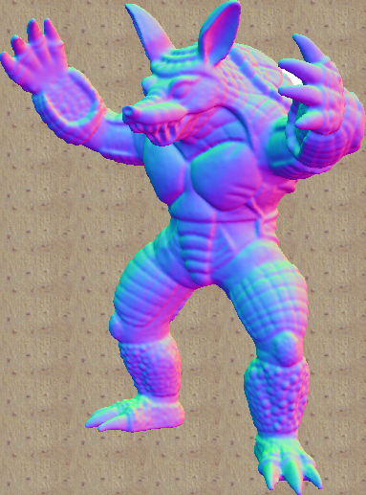
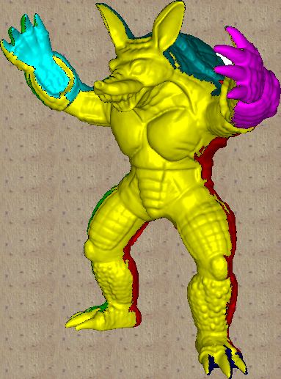
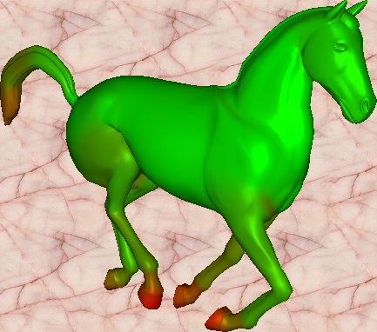
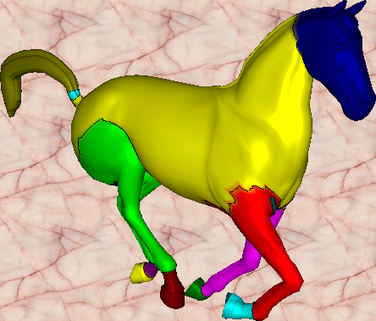
Segmentation Problem
Static
Dynamic

Slide 4
Mesh Animation
A sequence of key-frames representing how a static 3D shape is evolving through time
Rigid
High-deformable
Hybrid
{human, quadrupeds,…}
{cloth, facial,…}
{dancer,…}

Slide 5
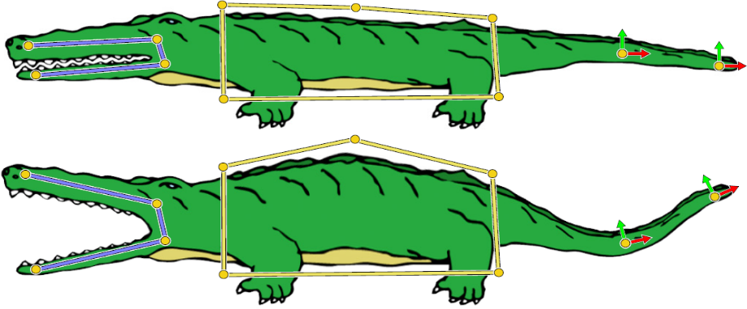
Production of Mesh Animations
Automatic:
User intervention:
time-varying
off-line
[Anguelov et al. TOG`05]
temporal-coherent
real-time
[Jacobson et al. TOG`11]

Slide 6
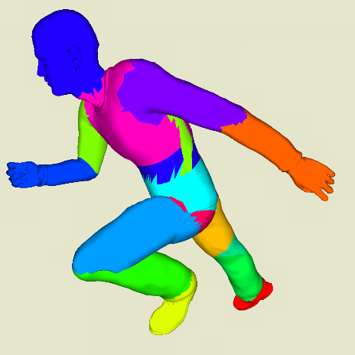
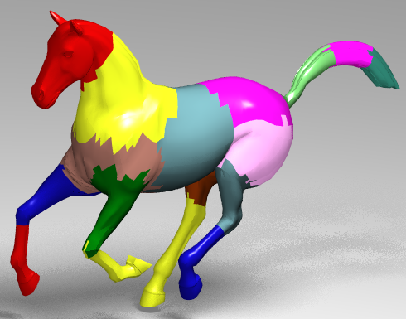
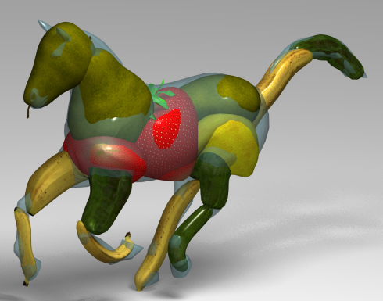
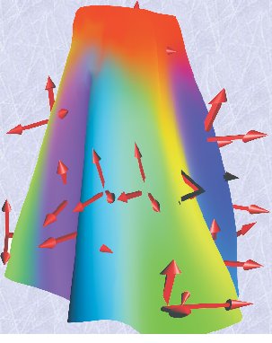
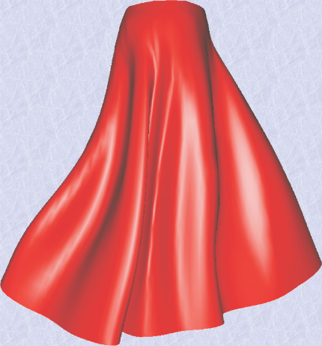
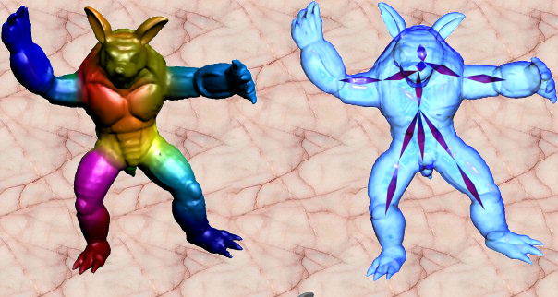
Why segmenting animated meshes?
Ray Tracing
Animation Collage
[Günther et al., CGF’06]
[Theobalt et al., SCA’07]
Skinning
Skeletonization
[Kavan et al., CGF’10]
[Le & Deng, TOG`11]
[De Aguiar et al., CGF`08]
[Hasler et al., I3D’10]
Notes:
Segmentation of mesh animations has become a key issue in a number of computer graphics applications…

Slide 7
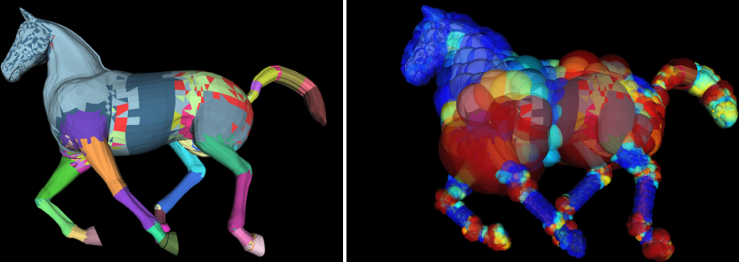
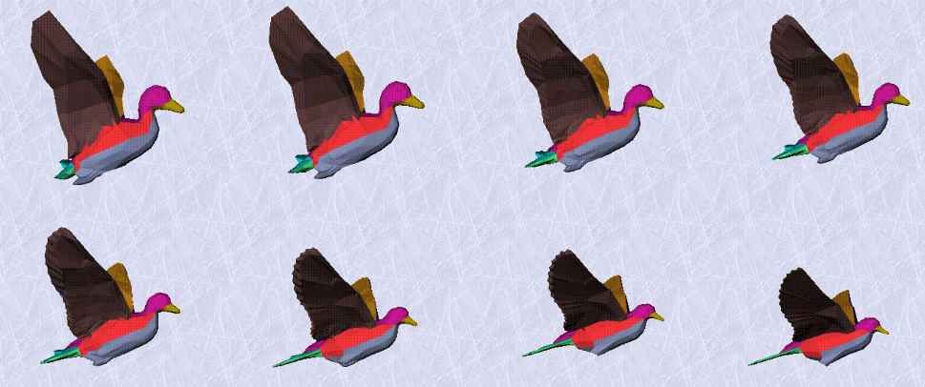
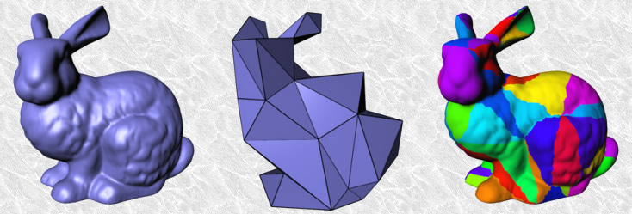
Why segmenting animated meshes?
Collision Detection
[James & Twigg, TOG`05]
[Wong et al., I3D’14]
Morphing
Geometry Images
[Shlafman et al., CGF`02]
[Feng et al., TOG`11]

Slide 8
Prior Art: Global Segmentation Methods
Feature Space
Clustering method
[Euclidean, geodesic, angular distances,…]
[k-means, hierarchical, spectral,…]

Slide 9
Prior Art: Limitations
detect segments with mostly [rigid] behavior
creation of [irregular shapes]
fail when feature space is [flat] or [anisotropic]
[uniform clustering] - [one feature dominates the other]
work only with [off-line] animations
[extend] or [edit] original animation
cannot offer smooth [multi-resolution] segmentations
[re-computation] is needed
cannot support [variable] segmentations
[detect motion changes]

Slide 10
Framework Overview
Given a mesh animation: $A=\left\{p_{0},p_{1},⋯,p_{k}\right\}$ with rest-pose $p_{0}:$
Feature Space of each pose${ p}_{i}$
Partitioning of each pose${ p}_{i}$
Over-Segmentation (OS)
Progressive Simplification of OS
OS(A)

Slide 11
(1,2) Per-pose Partitioning
Feature space computation
deformation measure from reference ($p_{0}$ or $p_{t−1}$) to target pose ($p_{t}$)
deformation gradient¹ → rotation angles
¹[Sumner et al., TOG`04]

Slide 12
(1,2) Per-pose Partitioning
Feature space computation
deformation measure from reference ($p_{0}$ or $p_{t−1}$) to target pose ($p_{t}$)
deformation gradient¹ → rotation angles
Partitioning computation
pose independence (parallelism)
top-down hierarchical clustering²
$C_{i}=\left\{C_{i}^{0},⋯,C_{i}^{l_{i}}\right\},∀p_{i}∈\left[1,⋯,k\right]$
¹[Sumner et al., TOG`04], ²[Günther et al., CGF'06]

Slide 13
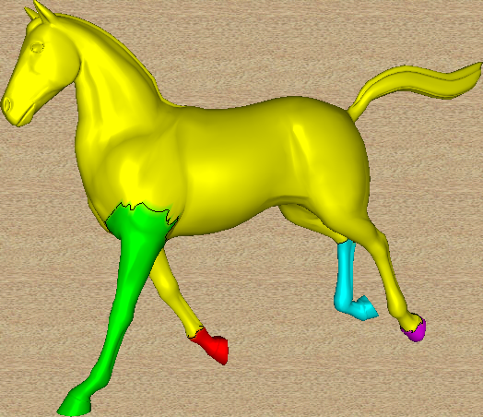
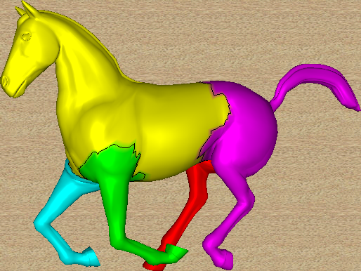
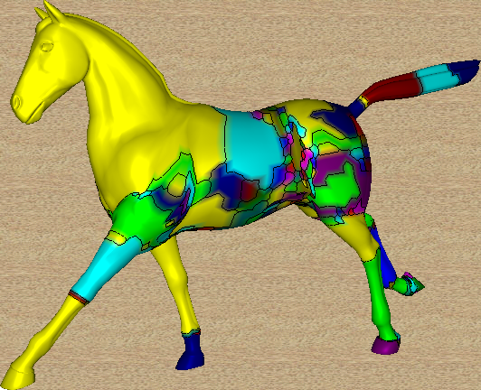
(3) Pose Partitioning-aware OS
Cluster Animation Vector (CAV)
$∀v∈V:cav\left(v\right)=\left\{m_{1},m_{2},⋯,m_{k}\right\},m_{j}∈\left[1,⋯,\left|C_{i}\right|\right]$
BFS: detect connected vertices with same CAV$→O\left(\left|V\right|\right) complexity$
$OS(A)=\left\{S_{0},S_{1},⋯,S_{r}\right\}$
$$cav\left(v_{j}\right)= \left\{0,4,⋯\right\}$$
0
0
$$v_{j}$$
…
4
3
1
3
1
2
4
2
$$C_{1}$$
$$C_{2}$$
$$OS(A)$$

Slide 14
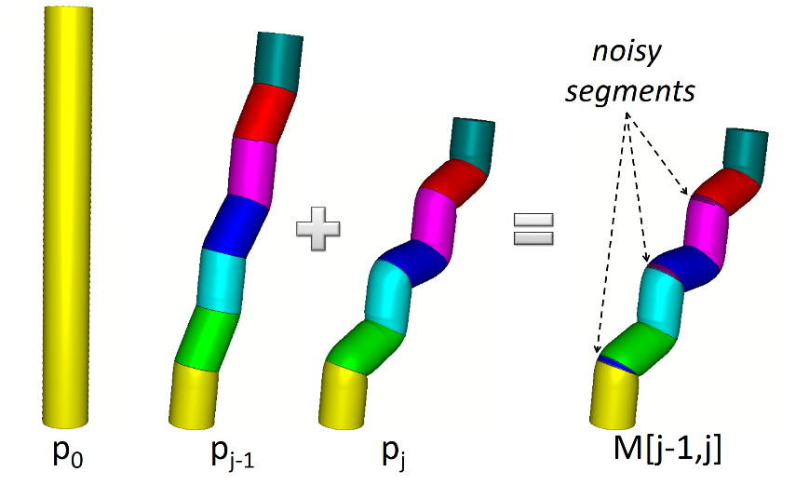
(4) Progressive Decimation of OS
Pose-to-pose Cleaning $R_{i}\left(h\right),h∈\left[0,1\right]$
$p_{k}→p_{k−1}→⋯→p_{1}$

Slide 15
(4) Progressive Decimation of OS
Pose-to-pose Cleaning $R_{i}\left(h\right),h∈\left[0,1\right]$
$p_{k}→p_{k−1}→⋯→p_{1}$
$C_{i}+C_{j}= ?$

Slide 16
Applications I
Smooth Visualization of Cluster Transitions
minimize “close” colors assigned to neighbors
propagate colors between consecutive frames
(a) Initial painting
(b) Color propagation

Slide 17
Applications II
Multi-resolution Segmentation
adjusting parameter $h:0 \left(high\right)→1\left(low\right)$
efficient: do not depend on mesh tessellation
bounded by $\left\{C_{1},\left|OS(A)\right|\right\}$- high similarity of $\left\{C_{i}\right\}$ ?

Slide 18
Applications III
Variable (temporal-consistent) Segmentation
$\left.\begin{aligned}\left(a\right) remain faithful to past data \\ \left(b\right) alter to future data\end{aligned} \right\}merge \{P_{t−1},P_{t}\}:M\left[t−1,t\right]→$ real-time
(a) Color propagation
(b) Variable segmentation

Slide 19
Applications IV
Real-time Segmentation
$\left.\begin{aligned}\left(∗\right) streamed/dynamic MA \\ \left(∗\right) out−of−core algorithm\end{aligned} \right\}merge \left\{M\left[1,t−1\right],P_{t}\right\}=M\left[1,t \right]→cost of C_{t}$
Real-time segmentation (left) without and (right) with p2p-cleaning

Slide 20
Applications V
Modifying Mesh Animations
add new poses → real-time segmentation
edit arbitrary pose $p_{t}:$ replace $C_{t}→C_{t}^{′}$ & recompute OS(A)
Combining Segmentations of Mesh Animations
$\left.\begin{aligned}A_{1} \\ A_{2} \\ ⋯ \\ A_{k}\end{aligned}\right\}$merge {$A_{i}$} → merge segmentations

Slide 21
Experimental Study I
Performance Analysis @Intel Core i7-870 Quad (2.83 Ghz)
linear behavior on the geometry size
linear scale when increasing per-pose partitionings
pose partitionings consume most of the time
tiny cost when moving from high to low resolutions

Slide 22
Experimental Study II
Quality Analysis I - Hand animation
$E_{RMS}:$ skinning approximation error
$\left.\begin{aligned}\left[rigid\right]→[volumetric parts] \\ \left[highly deformable\right]→[surface parts]\end{aligned}\right\} [hybrid]$
$$[our method]$$
$$[per pose feature space]$$
$$[\text{Schaefer}\text{ \& }\text{Yuskel}\text{, }\text{EG} \text{symp}\text{. }\text{on} \text{Geom}\text{.}\text{Pr}\text{. `07}]$$

Slide 23
Experimental Study II
Quality Analysis I - Horse gallop animation
$E_{RMS}:$ skinning approximation error
$\left.\begin{aligned}\left[rigid\right]→[volumetric parts] \\ \left[highly deformable\right]→[surface parts]\end{aligned}\right\} [hybrid]$
$$[our method]$$
$$[per pose feature space]$$
$$[\text{Gunther} \text{et} \text{al}\text{., }\text{CGF}\text{ `0}6]$$

Slide 24
Experimental Study III
Quality Analysis II – Flowing cloth animation
$E_{RMS}:$ skinning approximation error
$\left.\begin{aligned}\left[rigid\right]→[volumetric parts] \\ \left[highly deformable\right]→[surface parts]\end{aligned}\right\} [hybrid]$
$$[our method]$$
$$[per pose feature space]$$
$$[\text{Kavan} \text{et} \text{al}\text{., }\text{CGF}\text{ `}\text{1}\text{0}]$$

Slide 25
Experimental Study III
Quality Analysis II – Horse collapse animation
$E_{RMS}:$ skinning approximation error
$\left.\begin{aligned}\left[rigid\right]→[volumetric parts] \\ \left[highly deformable\right]→[surface parts]\end{aligned}\right\} [hybrid]$
$$[our method]$$
$$[per pose feature space]$$
$$[\text{Gunther} \text{et} \text{al}\text{., }\text{CGF}\text{ `0}6]$$

Slide 26
Experimental Study IV
Quality Analysis III – Samba animation
$E_{RMS}:$ skinning approximation error
$\left.\begin{aligned}\left[rigid\right]→[volumetric parts] \\ \left[highly deformable\right]→[surface parts]\end{aligned}\right\} [hybrid]$
$$[our method]$$
$$[per pose feature space]$$
$$[\text{Schaefer}\text{ \& }\text{Yuskel}\text{, }\text{EG} \text{symp}\text{. }\text{on} \text{Geom}\text{.}\text{Pr}\text{. `07}]$$

Slide 27
Experimental Study IV
Quality Analysis III – Handstand animation
$E_{RMS}:$ skinning approximation error
$\left.\begin{aligned}\left[rigid\right]→[volumetric parts] \\ \left[highly deformable\right]→[surface parts]\end{aligned}\right\} [hybrid]$
$$[our method]$$
$$[per pose feature space]$$
$$[\text{Schaefer}\text{ \& }\text{Yuskel}\text{, }\text{EG} \text{symp}\text{. }\text{on} \text{Geom}\text{.}\text{Pr}\text{. `07}]$$

Slide 28
Limitations
Performance Analysis
depends on computation time of individual pose partitionings:
$>90\%$ of the total time
Multi-source region growing → 6 fps: real-time segmentation of Hand animation
GPU-accelerated clustering ?

Slide 29
Limitations
Performance Analysis
depends on computation time of individual pose partitionings:
$>90\%$ of the total time
Multi-source region growing → 6 fps: real-time segmenting Hand animation
GPU-accelerated clustering ?
Quality Analysis
$depends on quality/number of individual pose partitionings$
Efficient low-detail segmentation output → similar per-pose partitionings
Accurate high-detail segmentation output → increased per-pose segments

Slide 30
Limitations
Performance Analysis
depends on computation time of individual pose partitionings:
$>90\%$ of the total time
Multi-source region growing → 6 fps: real-time segmenting Hand animation
GPU-accelerated clustering ?
Quality Analysis
$depends on quality/number of individual pose partitionings$
Efficient low-detail segmentation output → similar per-pose partitionings
Accurate high-detail segmentation output → increased per-pose segments

Slide 31
Conclusions & Future Work
Conclusions
handles off-line, real-time and editable mesh animations
supports rigid, highly-deformable and hybrid mesh animations
enables interactive multi-resolution & variable segmentations
introduces smooth visualization of segment transitions

Slide 32
Conclusions & Future Work
Conclusions
handles off-line, real-time and editable mesh animations
supports rigid, highly-deformable and hybrid mesh animations
enables interactive multi-resolution & variable segmentations
introduces smooth visualization of segment transitions
Future Work
support of time-varying meshes by exploiting vertex mapping
cluster similar poses to
handle extreme resolutions of OS
reduce computation/memory costs
increase the segmentation quality:
use of sophisticated mesh clustering algorithms
retain important (subset) per-pose partitions
rectify the generated segment boundaries

Slide 33
End();
thank_you();
answer_questions();
Acknowledgements
This research has been co-financed by the European Union (European Social Fund ESF) and Greek national funds through the Operational Program Education and Lifelong Learning of the National Strategic Reference Framework (NSRF) – Research Funding Program: Heracleitus II. Investing in knowledge society through the European Social Fund.

