Slide 1
Multiple Material Layer Visualization for Cultural Heritage Artifacts A. Moutafidou, I. Fudos, G. Adamopoulos, A. Drosou, D. Tzovaras
Notes:
Good afternoon,
My name is Anastasia Moutafidou and I am a PhD candidate at University of Ioannina,
and I will present you our work on “Multiple Material Layer Visualization for Cultural Heritage Artifacts”.

Slide 2
Outline
Scope
Introduction
Rendering
Multiple Material Layers
3D Printing with Transparency
Experiments
Conclusions
Notes:
Here you can see the outline of our presentation
We start with the Scope and the Introduction,
Then we go on with the main parts which are the Renderer, The Multiple Material Layers and the 3D Printing with Transparency
And we shall conclude with Experiments and Conclusions.

Slide 3
Outline
Scope
Introduction
Rendering
Multiple Material Layers
3D Printing with Transparency
Experiments
Conclusions
Notes:
So, let’s begin with the scope of this work.

Slide 4
1. Scope
Visualize material aging effects
Detect material changes in the underlying layers
Exporting 3D objects with transparency
Create an efficient visualization tool for emulation
Notes:
Curators and archeologists need to understand the nature of aging in order to inhibit it.
Our goal is to help them make the preservation more efficient and effective by developing software tools for:
Emulating and visualizing material aging effects.
Detecting material changes in the underlying layers.
Exporting 3D objects with transparency.
And finally providing an efficient user-intuitive visualization tool.

Slide 5
Outline
Scope
Introduction
Rendering
Multiple Material Layers
3D Printing with Transparency
Experiments
Conclusions

Slide 6
2. Introduction
An artwork piece :
May consist of different layers of materials
Which decay differently and
Could affect the local morphology of the object
So tools are needed for :
Realistic rendering
Aging simulation
Visualize different layers
Exporting models with transparency for 3D printing
Notes:
Curators are responsible for studying the aging effect on different objects.
Each artwork piece:
May consist of different layers of materials
Which decay differently and
may affect the local morphology of the object
So, it is of primary importance to help them with the appropriate tools (as stressed earlier) to apply their knowledge and to prevent further decay or even restore artifacts to a prior state.

Slide 7
Outline
Scope
Introduction
Rendering
Multiple Material Layers
3D Printing with Transparency
Experiments
Conclusions
Notes:
First, we have developed a visualization tool build on top of a powerful multifragment renderer.

Slide 8
3. Rendering
A rendered object consist of :
Triangulated mesh
Geometry of inner layers and outer surface
Texture maps
Properties of the surface
Physical Based Rendering technique can:
Combine all this information and
Realistically rendered objects
Notes:
A rendered object consists of:
Triangulated mesh which provide the geometry of the outer surface and the inner layers
But also, with texture maps which can refine the surface properties of a 3D object.
The most common technique for rendering is PBR.
This technique can combine different types of data to provide a more realistic result.

Slide 9
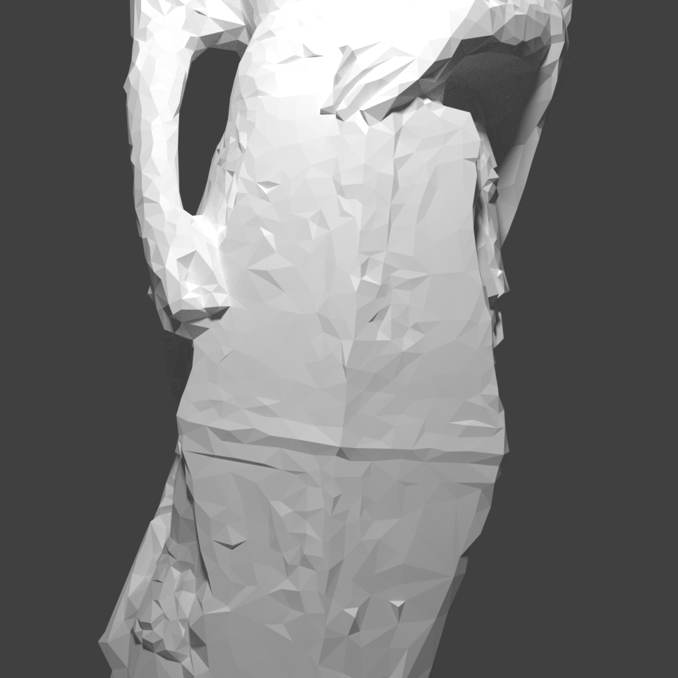
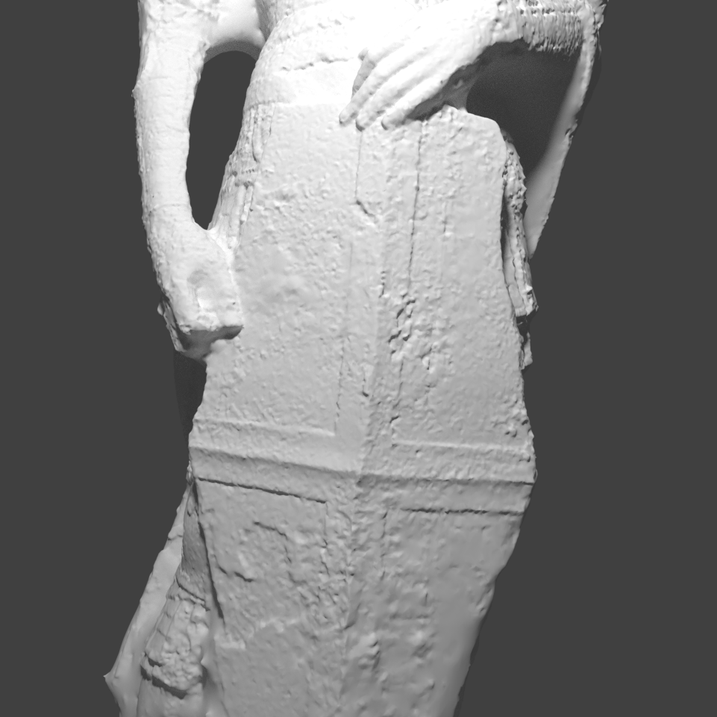
3. Rendering
Multiple sensors are used to provide data.
Outer surface reconstruction
Photogrammetry, Laser scanner
High resolution mesh
Low resolution photogrammetry, laser scanner
High resolution micro-profilometry
RTI for color
X-ray, ultrasound, ultraviolet for layers
Multiple material layer visualization
Notes:
Now we have multiple sensor data for our renderer.
For example, photogrammetry or laser scanner are often used for surface reconstruction.
Moreover, for the multiple layer visualization we can use
Microprofilometry measurements, RTI for the Color, and also x-ray or ultraviolent light for the layers.
Here is an example where we can see the results of these steps of the rendering process.

Slide 10
Outline
Scope
Introduction
Rendering
Multiple Material Layers
3D Printing with Transparency
Experiments
Conclusions
Notes:
Now let’s focus on multiple layers.

Slide 11
4. Multiple Material Layers
Our goal:
The ability to observe both outside and inside surfaces of an object
L2
L3
By using multi-fragment techniques we can browse changes as time evolves
Basic idea:
$$z_{1}$$
Store all the fragments per depth and sort them appropriately
$$z_{2}$$
$$z_{3}$$
$$z_{4}$$
Render only the k nearest fragments that belong to different layers (non intersecting layers, each layer is a non self intersecting, manifold watertight surface )
Notes:
Our main goal is to find a way to visualize the details of the volumetric geometry of a model.
So, our approach is to use a multi-fragment renderer to observe both the exterior and the interior of an object as time involves.
The basic idea is:
Store all the fragments per depth and sort them appropriately
Then render only the k nearest fragments that belong to different layers in the correct order.
By doing this we can ensure that there will be no silhouette artifacts as long as the layer models are closed solids with no holes.
For example, here we have 3 different layers. We can see that in layer number two we have a non-self -intersecting folding boundary surface.
As we move on in discovering new fragments from various layers, we can see that we encounter two different front-facing fragments in different depth but for the same layer.
So, in this case we keep only the first front facing while we ignore all subsequent front-facing and back-facing fragments.

Slide 12
4. Multiple Material Layers
For each pixel the rgb color value of the $i_{th}$ fragment $f_{i}$ is a weighted sum of the colors of the fragments, influenced by the user preference.
$col\left(f_{i}\right).a= \left\{\begin{aligned}\frac{1}{d}v_{a} ,if{ f}_{i} is highlighted \\ \frac{1}{k−d}\left(1−v_{a}\right) ,if{ f}_{i} is not highlighted\end{aligned}\right.$
L1
L2
L3
L4
$$col.rgb= \sum_{i=1}^{k}{col\left(f_{i}\right).a∗col\left(f_{i}\right).rgb}, where \sum_{i=0}^{k}{col(f_{i})}.a=1$$
The α value of fragment${ f}_{i}$ is determined by the user preferences d and $v_{a}$ as follows:
0.1
0.4
0.4
0.1
$v_{a}$= 0.8
Notes:
Each model has k different layers.
The user will be able to select a number of layers that will be highlighted.
For each pixel the rgb color value of the 𝑓_𝑖 fragment is a weighted sum of the colors of the fragments, influenced by the user preference.
Here is the corresponding formula
Where
The α value of the fragment is determined by the user preferences,
d is the number of the highlighted layers and
𝑣_𝑎 specifies how much the highlighted layers (and subsequently the non-highlighted layers) will contribute to the final result.
Here is the corresponding formula and we on the left we can see a simple example
Here, we have 4 different layers.
As a user I want to highlight layers two and three
And also give the value 0.8 to the va parameter.
So accordingly, to our formulas we should distribute 0.8 to the two layers two and three
and the remainder 0.2 to the other two layers accordingly.

Slide 13
Outline
Scope
Introduction
Rendering
Multiple Material Layers
3D Printing with Transparency
Experiments
Conclusions
Notes:
Next, we can move with our 3D printing support.

Slide 14
5. 3D Printing with Transparency
Inner layers of a 3D model are not visible when they are exported
We built a process to allow the user to select certain areas that will be printed with transparency
Summarize the basic steps :
1. Select the area that will be transparent (selection box)
2. Add transparent value on the corresponding textures according to [1].
3. Perform clipping of all triangles (Hodgeman-Sutherland)
4. Create a custom window to browse the inner layers
5. This process can be repeated with several boxes
San Giorgio statue made by Donatello (1415)
1. ALAN BRUNTON CAN ATES ARIKAN T. M. T., URBAN P.: 3d printing spatially varying color and translucency. Siggraph 2018, Vancouver, to appear (2018).
Notes:
The observation of the inner layers is an important work for the curators, when they are involved in the process of preserving.
So, when an object is exported with the standard stl format for printing the inner layers are not visible.
For that reason, there is a need for a process that will enable a user to select certain areas that will be printed with transparency.
We use a technique for facilitating transparent printing based on the alpha value of the textures (reference ?)
We can summarize this process in 4 basic steps.
Select the volume that will be transparent by using a selection box.
The faces of the model that are inside the box will have transparent value on the corresponding texture during export.
These faces consist of triangles which are the result of clipping with the selection box.
And finally, as a result we have created a custom window to browse the result prior to 3D printing.
This process can be repeated with several selection boxes

Slide 15
Outline
Scope
Introduction
Rendering
Multiple Material Layers
3D Printing with Transparency
Experiments
Conclusions
Notes:
Now we go on with the experiments

Slide 16
6. Experiments
We have conducted two types of experiments :
Quantative results
To evaluate the performance of our tool
Qualitative results
To visualize multiple layers and surface geometry
Notes:
We have conducted two types of experiments:
Quantitive in order to evaluate the performance of our tool.
And Qualitative to see some results with multiple layers and surface geometry.

Slide 17
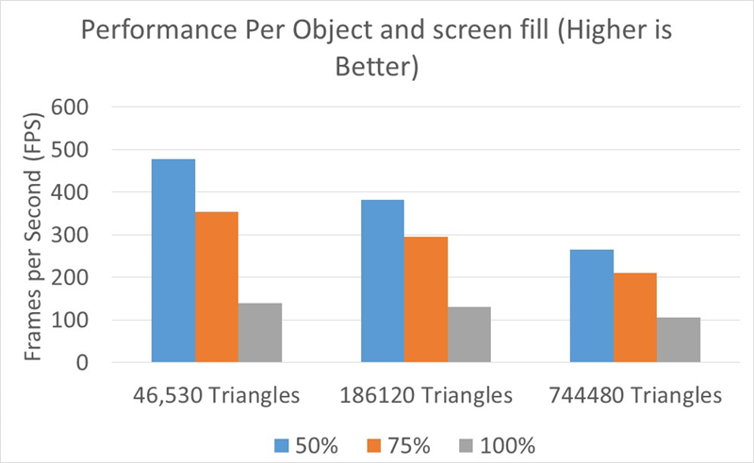
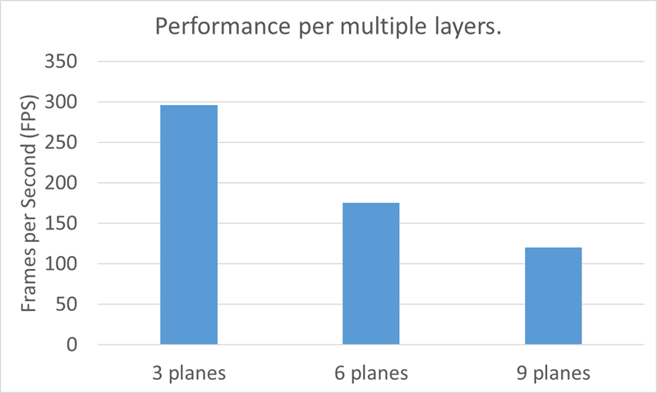
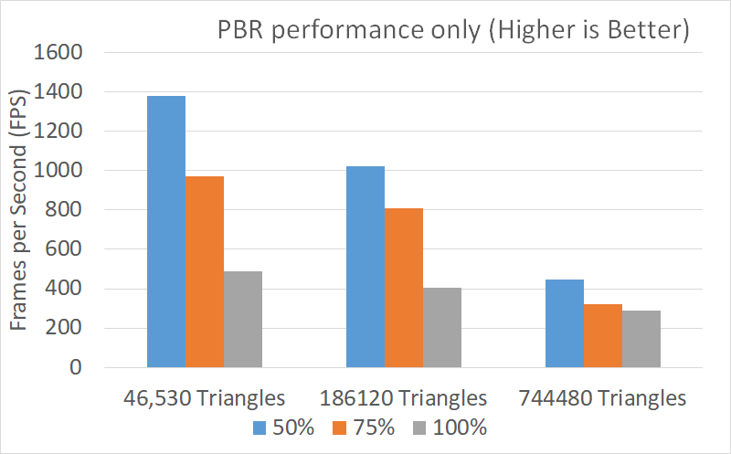
1. Quantitative
Multiple Layers Visualization
Physical Based Rendering performance
Rendering performance and
screen population
3 layers
6 layers
9 layers
Notes:
Let’s start with the Quantitive results
Because our method is based on fragments the first result we can see is the performance of our rendering tool for the same screen resolution which is (1024*1024)(ten twenty four by ten twenty four)
We have used 3 different objects with different number of triangles for different screen population (50,75,100%).
---------------------------------------------------------
All the objects that we have used have 3 different layers with the same geometry at different resolution. We have a
Low res mesh with 46.530 triangles,
A Medium res mesh with 186.120
And a High res mesh with 744.480.
And despite the fact that the number of triangles been largely varied does not cause significant drop in FPS as we can see.
------------------------------------------------------------------
Next, we have the performance of multiple layers.
If we double or triple the number of layers, we observe a linear drop in FPS.
-------------------------------------------------------------
Finally, we have the PBR performance.
We can see that for large number of triangles we have low performance rates and for small number of triangles we have a high-performance value.

Slide 18
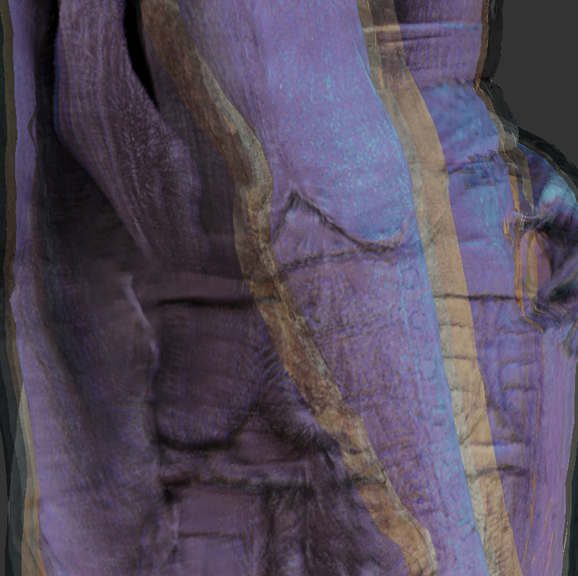
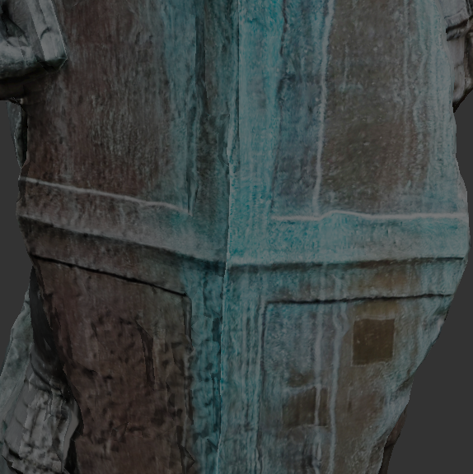
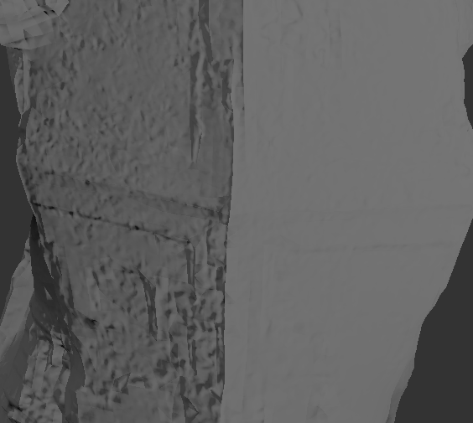
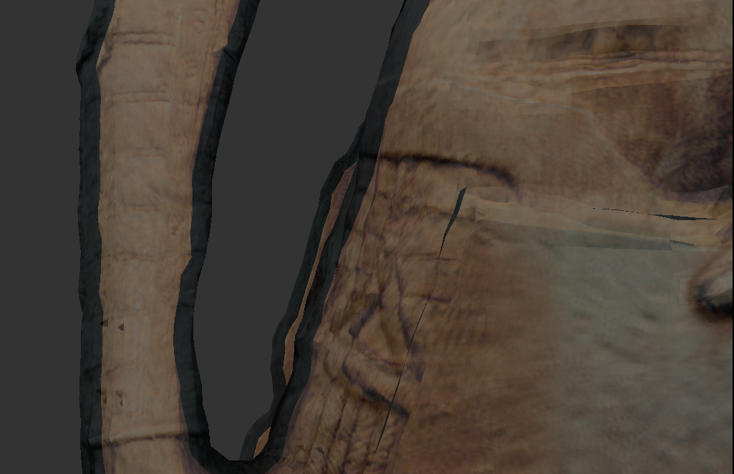
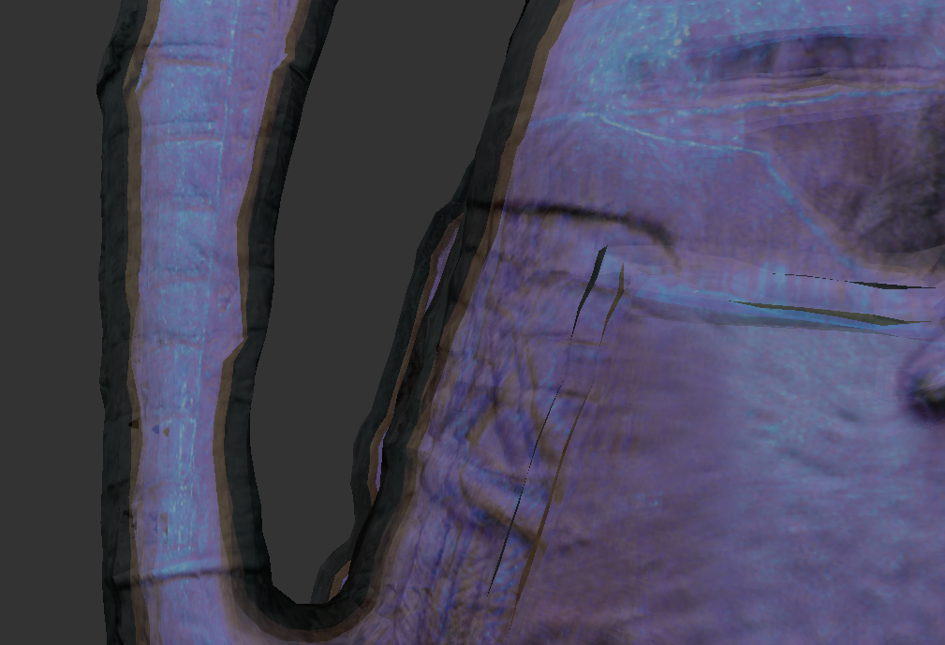
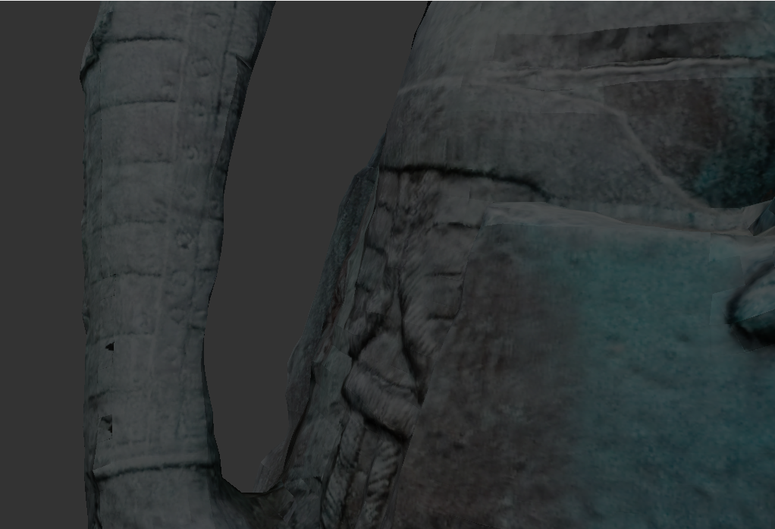
2. Qualitative
Rendering Multiple Material Layers
A detail of rendering original geometry
Black = outer
Same object different point of view
Beige = middle
Object with normal map
No additional information
PBR result with RTI data
Layer 1 (outer)
Layer 3 (outer + middle + inner)
Layer 2 (outer + middle)
Magenta = inner
Notes:
Let’s see some Qualitative experiments.
First, we can see a rendering procedure of an object where
The first picture is the original object without additional information utilized
Here we can see the details on the surface by using a normal map extracted from microprofilometry measurements
And in the final image is the PBR result with RTI sensor data.
-----------------------------------------------------------------------
Then we can see an object with rendering multiple material layers.
Here is the outer layer,
The middle along with the outer
All the 3 layers together.
And here is the same object from a different point of view.

Slide 19
Outline
Scope
Introduction
Rendering
Multiple Material Layers
3D Printing with Transparency
Experiments
Conclusions
Notes:
Finally, to sum up our work

Slide 20
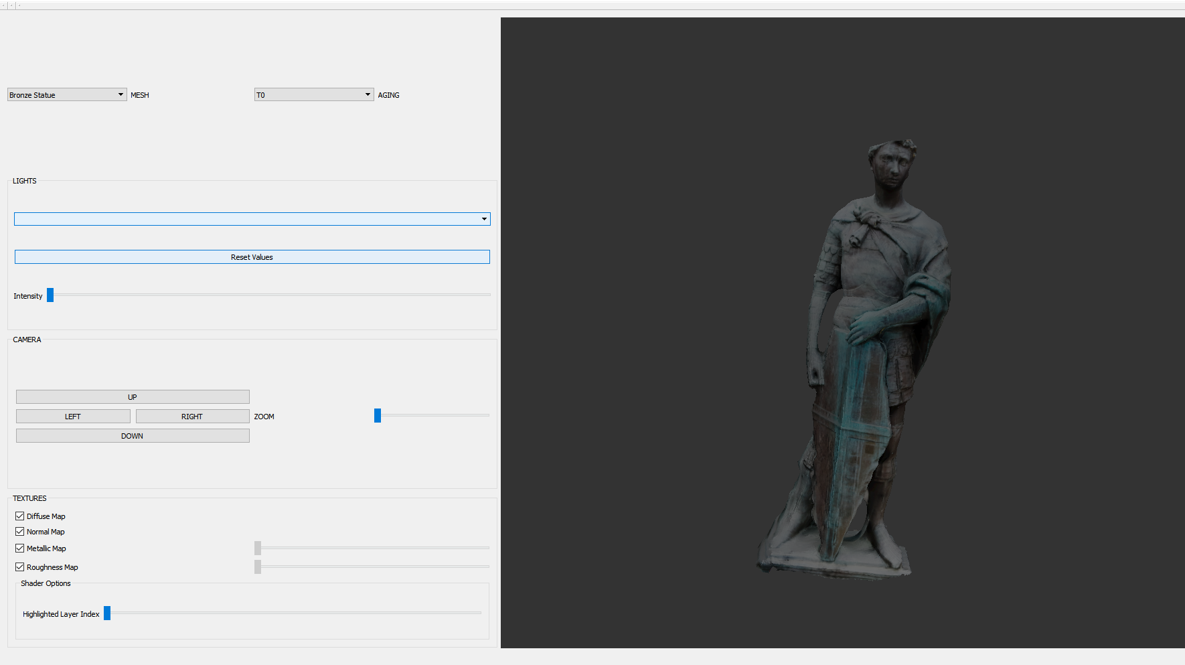
7. Conclusions
We have developed a tool for supporting
multiple material layers
several visualization techniques
Notes:
We have developed a tool in to efficiently visualize multiple material layers
Along with some additional visualization techniques.

Slide 21
THANK YOU!

